Slide 1
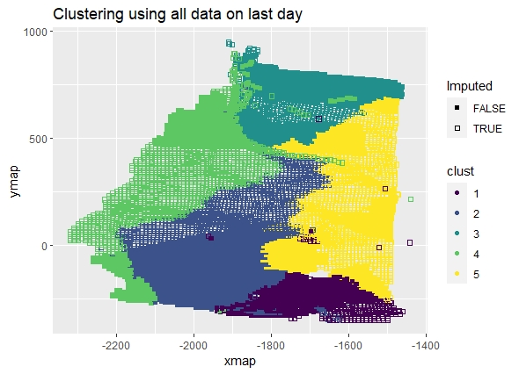
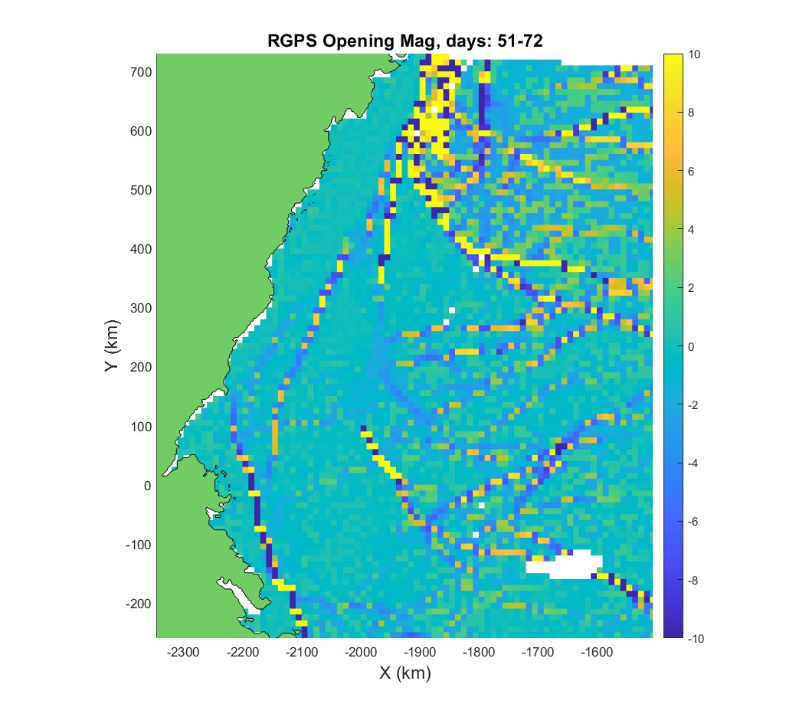
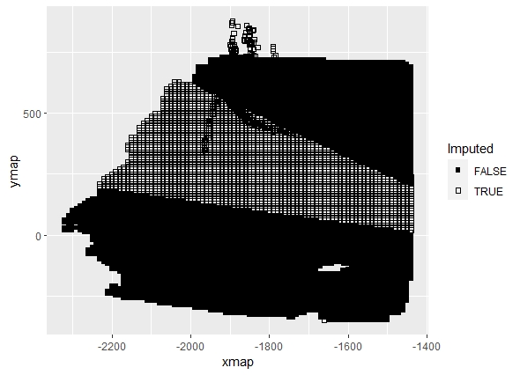
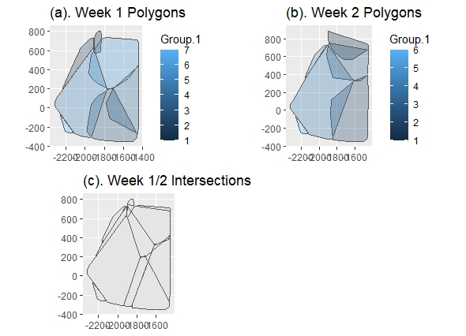
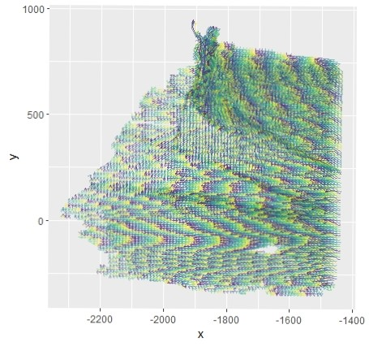
A Spatio-Temporal Model for Arctic Sea Ice
Alison Kleffner, Yawen Guan, Susan VanderPlas
Department of Statistics, University of Nebraska - Lincoln
Introduction
Sea ice is frozen water in the Arctic Ocean that generally occurs as an ice pack which can drift over the oceans surface Understanding ice dynamics plays a vital role in climate models Cracks, or leads, may form in the ice pack due to dynamic processes Allows for heat from the ocean to be transferred to the atmosphere, accounting for part of the heat flux between the ocean and the atmosphere Other Ice Lead Detection Methods Generally, involve the use of thermal images or deformation calculations found through satellite images Satellite images have drawbacks of being low in resolution and are affected by atmospheric conditions, thus may lead to inaccurate calculations
Bounding Box Clustering
Created a bounding box, made of different features, around each trajectory, to represent the movement of the trajectory over time. Features used: Length of x/y traveled (between max and min location) Difference in x/y from latest to earliest observation Angle of movement Average x/y value Can use previous information. Then used kmeans clustering, where number of clusters was determine using the silhouette width.
Results
Clustering Interpolation Assign 10% in desired time/intersection combination to be missing Used data in intersection from day before and day after to develop model
Intersection Interpolation
Due to the data collection method, when data is missing, it tends to be missing in chunks Method involves defining the spatio-temporal neighbors for each missing point, using our previously made clusters Clusters, using our Bounding Box Method, were created for each week The overlap of one week’s clusters with the week before and week after would create groups, where each member is a spatio-temporal neighbor of the other members. This is because members of these groups are in a similar geographic region over time. A spatial grid encompassing the data was created for each time to give an initial starting point for the estimation of the missing points, using the centroid of the gird cell. Create a univariate model for both x and y to estimate the missing locations. The models were created using the GpGp package in R, which uses the Vecchia’s approximation in order to speed up the computation of the Gaussian Process, where the covariance function was defined as the exponential space-time. The output for this model is the maximum Vecchia likelihood estimates for the mean and covariance parameters. These estimates then can be used to predict the unobserved locations at that time. The grid estimates of the x and y values are used as the starting locations in the predicted function. From this, predictions for x or y are done using their fitted model
Data
Used motion data from the RADARSTAT Geophysical Processing System (RGPS) The movement of sea ice is tracked in sequential radar images and they are usually tracked until melting season begins Due to this data collection, data may be missing due to the satellite used to obtain the SAR images not passing over part of the sea ice at a given time
RMSE for Week 1 Missing Data
 | Intersection Method |  | Linear Interpolation
Cluster | X | Y | X | Y
1 | 3.137 | 4.276 | 3.199 | 13.042
2 | 4.364 | 4.622 | 0.187 | 0.359
3 | 2.647 | 3.139 | 1.314 | 3.066
4 | 3.006 | 2.873 | 1.396 | 2.442
5 | 3.946 | 3.561 | 0.74 | 3.036
6 | 3.109 | 3.08 | 1.876 | 5.459
Conclusion
Method Motivation
It can be seen in this figure that there seems to be groups movement patterns within the ice pack. Tracked identifiers in the ice sheet can be grouped together when have similar movement. This may be accomplished by using a clustering The idea is that sea ice crack may form on the border between clusters.
References
QUESTIONS?
Email: akleffner@huskers.unl.edu

